Slide 1
Research-Based Presentation Design

Slide 2
Johnstone, A. H., & Percival, F. (1976). Attention breaks in lectures. Education in Chemistry, 13, 49-50.
Level of Attention
Increasingly Shorter Periods of Attention
Settling Down 3 or 5 minutes
Lapse of Attention 10 to 18 minutes
End of Lecture 3 to 4 minutes

Slide 3
Burns, A. (1985, May). Information impact and factors affecting recall. Paper presented at the Annual National Conference on Teaching Excellence and Conference of Administrators, Austin, TX. (Eric Document Reproduction Service No. ED 285 639).
Level of Recall
5
Min.
5
Min.
5
Min.
5
Min.

Slide 4
Morgan, R. L., Whorton, J. E., & Gunsalus, C. (2000). A comparison of short term and long term retention: Lecture combined with discussion versus cooperative learning. Journal of Instructional Psychology, 27(1), 53-58.
Students in a special education course
Students had better short-term memory when lecture was combined with discussion over lecture combined with cooperative learning.
No difference for long-term memory.

Slide 5
Lectures with PowerPoint
Do students learn better when lecturers use PowerPoint?
Well, maybe.
Students preferred PowerPoint over traditional lecture
Students focus on what is in the slides over what is being said
PowerPoint negatively impacted retention of examples
Performance was equivalent
Savoy, A., Proctor, R. W., & Salvendy, G. (2009). Information retention from PowerPoint and traditional lectures. Computers and Education, 52, 858-867.

Slide 6
Why Use Visuals in Presentations?
Transparencies, PowerPoint, & Enhanced PowerPoint
Students liked PowerPoint better than transparencies retrospectively
Students believed they learned more from PowerPoint
Students performed worse on enhanced PowerPoint than the other two
Graphics have to be pertinent to the presentation
Bartsch, R. A., & Cobern, K. M. (2003). Effectiveness of PowerPoint presentations in lectures. Computers & Education, 41, 77-86.

Slide 7
Why Use Visuals in Presentations?
Percent Retention in 3 Presentation Styles After 3 Hours and 3 Days
 | Verbal only | Visual only | Verbal and visual
Retention after 3 hours | 70 | 71 | 84
Retention after 3 days | 10 | 20 | 64
Vogel, D. R., Dickson, G. W., & Lehman, J. A. (1986). Persuasion and the role of visual presentation support: The UM/3M study. ISRC-WP-86-11. Retrieved https://www.misrc.umn.edu/workingpapers/fullpapers/1986/8611.pdf

Slide 8
Most Presentations Are:
A calculated attempt to transfer information to a specific group.
A lecture
Direct instruction

Slide 9
When To Use DI
Information transfer is the object of the presentation
Information is not available elsewhere
Information organized in specific way
Need to get audience interested
Information needs to be summarized
Orlich, D. C., Harder, R. J., Callahan, R. C., Trevisan, M. S., & Brown, A. H. (2004). Teaching strategies: A guide to effective instruction. New York, NY: Houghton Mifflin.
Stein, M., Carnine, D., & Dixon, R. (1998). Direct instruction: Integrating curriculum design and effective teaching practice. Intervention In School & Clinic, 33(4), 227.
Notes:
5

Slide 10
DI Presentation Components (from the presenter’s point of view)
Understanding
Structuring
Sequencing
Explaining
Presenting
Notes:
6

Slide 11
DI Understanding
Determine audience’s current knowledge
Current level of content knowledge
Selection and Integration
Process knowledge
Ability to Organize information
Mayer, R. E. (1996). Learning strategies for making sense out of expository text: The SOI model for guiding three cognitive processes in knowledge construction. Educational Psychology Review, 8, 357–371.

Slide 12
Selection/Organization/Integration (from the listener’s point of view)
Mayer’s SOI Model, 1996
Your Brain
Sensory Register
Working Memory
Long-Term Memory
Information
What gets recognized
Knowledge Model
Combining with Prior Knowledge
Prior Knowledge
Selecting
Organizing
Integrating

Slide 13
DI Structuring
Establish purpose of lesson
Assist with Selection
Present organization of lesson
Assist with Organization
Summarize
Assist with Integration

Slide 14
DI Sequencing
Present in logical order (Organizing)
Advanced organizers
Outlines
Present in order of increasing complexity (Selecting)

Slide 15
DI Explaining
Defining terms
Use examples
Accurate
Concrete and fewer abstract
Student experiences
Personal examples

Slide 16
DI Presenting
Clarity/Enthusiasm
Avoid vagueness
Humor
Concepts per time
Immediate feedback
frustration, confusion, misunderstanding
Mistakes and problems
20 minutes maximum

Slide 17
DI Feedback
On-going
Post assessment
Self-check

Slide 18
Lecture and Retention
The 10 principles of teaching for transfer
For our discussion:
4. Learning is based on prior knowledge
7. Lectures work better for learning assessed with recognition tests
9. Less is more
Halprern, D. F., & Hakel, M. D. (2003). Applying the science of learning to the university and beyond: Teaching for long-term retention. Change: The magazine of Higher learning, 35(4), 36-41.

Slide 19
When are Presentations Sometimes Ineffective?
Not paying attention to what the audience expects
Poor presentation design
Content
Style
Unprofessional delivery

Slide 20
The 3 Questions
What does my audience expect in my presentation?
What do I need to present?
How should I present it?

Slide 21
What does my audience expect in my presentation?
Lecture
To sit passively and to be told in a comprehensive and organized manner about something that is probably new to me.
Research conference presentation
To probably sit passively and be told in an abbreviated but clear manner about the results of a new study. I may leave if I want. I may ask questions.
Proposal defense
To participate as an expert in either the content or methodology of the suggested study.
To engage in a discussion with not only the presenter but other audience participants.

Slide 22
What do I need to present?
Lecture
A comprehensive and organized body of material probably supported by graphic reinforcement.
Conference presentation
A concise description of the study design and results supported by graphic reinforcement.
Information about how listeners can find out more if they want.
Proposal defense
Whatever your chair says to present but probably the following:
The problem statement
A description of why this is worth studying
An organized but condensed review of the literature
A clear and comprehensive explanation of the proposed methods of study
Possibly a timeline for completion

Slide 23
How should I present it?
You cannot assume that the audience is interested in what you have to say. You have to convince them.
Any distraction from the process of convincing the audience of the importance of what you are saying risks losing them.
That is what the rest of this presentation is about.

Slide 25
Making Slide Design Not be a Distraction
Type

Slide 26
A Quick Primer on Type

Slide 27
Type Fonts
Times
Helvetica
Palatino
Monaco
Apple Chancery
Chalk Duster
Serif
Sans Serif
Screen Serif
Monospace
Script
Display

Slide 28
Font Selection
Ease of reading
Song, H., & Schwarz, N. (2008). If it's hard to read, it's hard to do: Processing fluency affects effort prediction and motivation. Psychological Science, 19, 986–988.
Font neutrality
Oppenheimer, D. M., & Frank, M. C. (2008). A rose in any other font would not smell as sweet: Effects of perceptual fluency on categorization. Cognition, 106, 1178–1194.
Both of these support fonts like Times and Arial

Slide 29
The quick brown fox jumped over the lazy dog. The quick brown fox jumped over the lazy dog.
Display fonts are harder to read and are never neutral

Slide 30
The quick brown fox jumped over the lazy dog. The quick brown fox jumped over the lazy dog.
With body text (large amounts of text) serifed fonts are easier to read.

Slide 31
NOW IS THE TIME FOR ALL GOOD PEOPLE TO COME TO THE AID OF THEIR COUNTRY. Now is the time for all good people to come to the aid of their country.
All Caps is harder to read.

Slide 32
NOW IS THE TIME FOR ALL GOOD PEOPLE TO COME TO THE AID OF THEIR COUNTRY. Now is the time for all good people to come to the aid of their country.
All Caps Readability

Slide 33
The longer the line the more spacing that is needed between lines
This study examined the concurrent validity of assessments based on a prescribed set of preparation standards of teacher candidate competency.
This study examined the concurrent validity of assessments based on a prescribed set of preparation standards of teacher candidate competency.
This study examined the concurrent validity of assessments based on a prescribed set of preparation standards of teacher candidate competency.

Slide 34
Type Size
1/25 of the image height minimum
14 point
18 point
24 point
28 point
32 point
36 point
40 point
About 1/25

Slide 35
Direct Instruction Instruction which has an academic focus, presents little choice of activity by the students, favors large group over small-group instruction, and focuses on factual questions and controlled classroom practice (Orlich, 1994) Positive characteristics of Direct Instruction - provides for delivery to the entire class - controls focus of attention - makes the most of the time available - assesses feedback quickly from the class to ensure understanding - allows the teacher to answer student questions that may be of interest to the class as a whole only once - provides the teacher with the option of using student reactions to modify a lesson or an activity - allows the teacher to use a student to explain directions or provide insight into the lesson or activity - requires less preparation time than many alternative instructional strategies - stresses the teacher’s ability to motivate - allows all students the same amount of time on task
Use a maximum of 25 words per slide

Slide 36
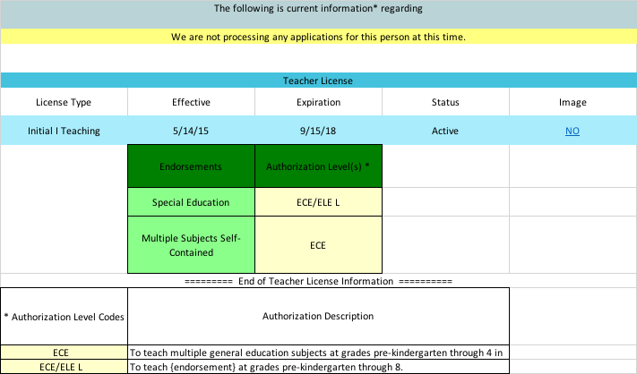

Slide 37
A Related Problem That is not Really About Type
No one should sit more than 8 times the height of the projected image away from the screen

Slide 38
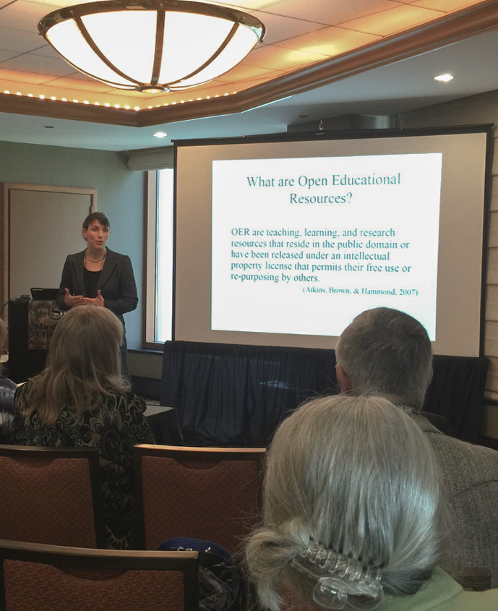
Aspect Ratio
16 x 9
4 x 3

Slide 39
4:3 slide on a 16:9 screen

Slide 40
16:9 slide on a 4:3 screen

Slide 41
Finding the controls in PowerPoint

Slide 42
Making Slide Design Not be a Distraction
Graphics

Slide 43
Working In a 300 DPI World

Slide 44
Graphics: Solution 1
Draw It Yourself

Slide 45
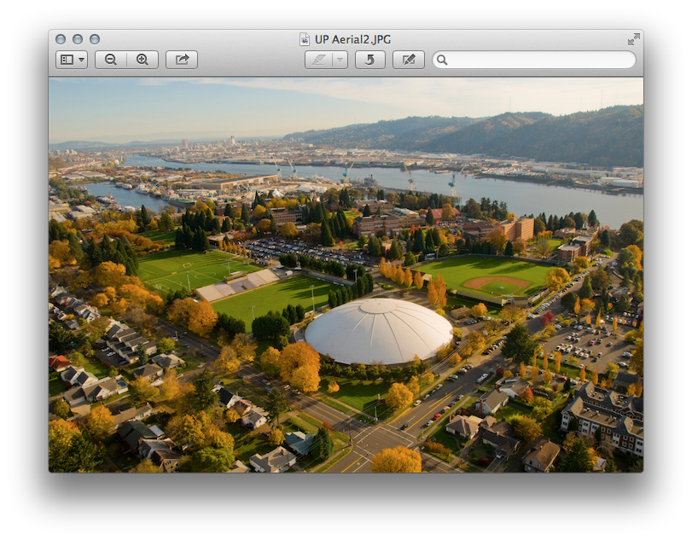
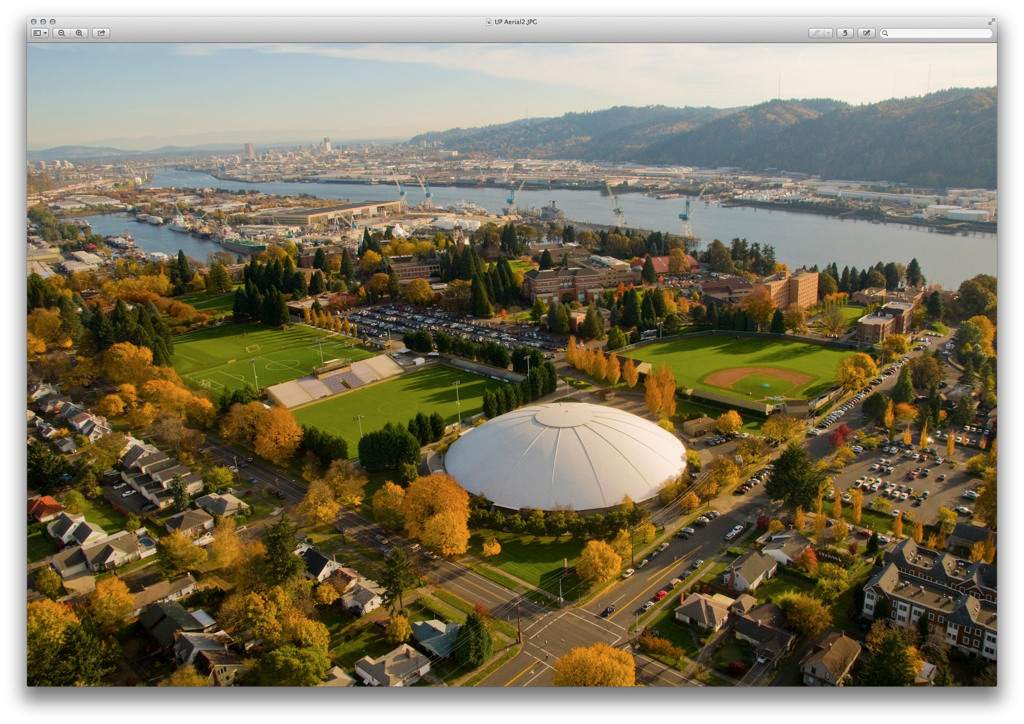
Graphics: Solution 2
Learn to Make Screenshots
1. Shoot Big 2. Differences Between PNG & JPG
¼ screen
full screen

Slide 46
Graphics: Solution 3
Using PowerPoint
Produce a slide to be a unique graphic
Fill the space
Select All then Arrange/Group
Right click on the group/Save as Picture
Experiment with file format
I mostly use TIFF (print graphics) or PNG (web)
Photoshop or Illustrator
OR just leave it as a PP graphic

Slide 47
Graphics: Solution 3
Using PowerPoint
Hi!

Slide 48
Graphics: Solution 4
Get it off the web
images.google.com
Look for large file sizes
Give credit when due
Search for “image databases”
Even though you got it off the web it may still need editing.

Slide 49
220 x 154
1980 x 1100

Slide 50
Graphics: Solution 5
Make your own photos
Take at the highest resolution settings
Get what you are interested in to fill the frame
Get a good photo editor

Slide 51
A Brief Word About Decoration
Sometimes presentations need to connect with viewers who expect to be visually entertained.
Use decoration and visual examples cautiously
Be careful that decoration does not obscure the message
Never judge readability from a computer screen

Slide 52
This slide is perfectly readable on the computer screen

Slide 53
Google Image Searches

Slide 54
Putting it Together: Design and Delivery

Slide 55
The Science of Presentations Mayer et al.

Slide 56
Pictures/Text/Narration
Mayer’s Multimedia Learning, 2001
Multimedia Presentation
Sensory Memory
Working Memory
Long-Term Memory
Written and Spoken Words
Ears
Selecting Words
Sounds
Organizing Words
Verbal Model
Integrating
Prior Knowledge
Pictures
Eyes
Selecting Images
Images
Organizing Images
Pictorial Model
Cognitive Overload

Slide 57
Pictures/Text/Narration
Mayer’s Multimedia Learning, 2001
Multimedia Presentation
Sensory Memory
Working Memory
Long-Term Memory
Written and Spoken Words
Ears
Selecting Words
Sounds
Organizing Words
Verbal Model
Integrating
Prior Knowledge
Pictures
Eyes
Selecting Images
Images
Organizing Images
Pictorial Model
Cognitive Overload

Slide 58
Pictures/Text/Narration
Mayer’s Multimedia Learning, 2001
Multimedia Presentation
Sensory Memory
Working Memory
Long-Term Memory
Written and Spoken Words
Ears
Selecting Words
Sounds
Organizing Words
Verbal Model
Integrating
Prior Knowledge
Pictures
Eyes
Selecting Images
Images
Organizing Images
Pictorial Model
Cognitive Overload

Slide 59
Pictures/Text/Narration
Mayer’s Multimedia Learning, 2001
Multimedia Presentation
Sensory Memory
Working Memory
Long-Term Memory
Written and Spoken Words
Ears
Selecting Words
Sounds
Organizing Words
Verbal Model
Integrating
Prior Knowledge
Pictures
Eyes
Selecting Images
Images
Organizing Images
Pictorial Model
Cognitive Overload

Slide 60
Reducing Extraneous Processing (Mayer)
Coherence principle—remove extraneous material

Slide 61
Slide Content
Ed 530 Dimensions of Education
Add as much text as is necessary to present an idea clearly—then reduce that quantity.
Consider carefully any information on the slide which is not related to the presentation content.
University of Portland MAT

Slide 62
Slide Content
Add as much text as is necessary to present an idea clearly—then reduce that quantity.
Consider carefully any information on the slide which is not related to the presentation content.

Slide 63
Reducing Extraneous Processing (Mayer)
Coherence principle—remove extraneous material
Signaling principle—emphasize what is most important. Works better with text than graphics.

Slide 64
Signaling
Main point
Lesser idea
Another main point
Another lesser idea
Or this can be done with text emphasis

Slide 65
Signaling
Main point
Lesser idea
Another main point
Another lesser idea
Or this can be done with text emphasis
Graphics do not do this as well as text emphasis

Slide 66
Reducing Extraneous Processing (Mayer)
Coherence principle—remove extraneous material
Signaling principle—emphasize what is most important. Works better with text than graphics.
Redundancy principle—images, text, and narration can be too much.

Slide 67
Redundancy
Multiple media are not necessarily additive
If it is important that viewers get information by reading the screen be sure it is easy for them to read.
If it may be more difficult for them to read then STOP TALKING!

Slide 68
Reducing Extraneous Processing (Mayer)
Coherence principle—remove extraneous material
Signaling principle—emphasize what is most important. Works better with text than graphics.
Redundancy principle—images, text, and narration is too much.
Spatial contiguity principle—put the words next to the relevant graphic.
Temporal contiguity principle—narration should be overlayed on graphics, not before or after.

Slide 69
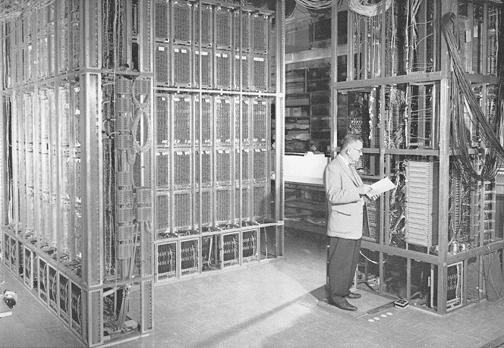
What was the year computer-based instruction was first used?
• 1959 Programmed Logic for Automatic Teaching Operations (PLATO)
1959 Programmed Logic for Automatic Teaching Operations (PLATO)

Slide 70
Reducing Extraneous Processing (Mayer)
Coherence principle—remove extraneous material
Signaling principle—emphasize what is most important. Works better with text than graphics.
Redundancy principle—images, text, and narration is too much.
Spatial contiguity principle—put the words next to the relevant graphic.
Temporal contiguity principle—narration should be overlaid on graphics, not before or after.

Slide 71
Before we leave Mayer…
Personalization Principle: Personalized language works better than formal
Voice Principle: Conversational voice works better than machine voice
This means you should never read a presentation (no matter how nervous you are about getting to everything).

Slide 72
Change Blindness
Occurs when similar slides are back to back and no visual transition is used.
Pick transitions cautiously but still use them, particularly in longer presentations

Slide 73
A few other things
PowerPoint allows lots of effects, many of which are extremely irritating.
Being a good presenter means being comfortable with what you are doing. That means practice.
When setting up a presentation, open all the applications you may use before you start.

Slide 74
Common Problems
Way too much text (extraneous material)
The computer going to sleep in the middle of a presentation
Presenters reading slides (machine voice)
Bad transitions between applications
Presenters not paying attention to the audience

Slide 75
Delivery of Instruction
Practice presentation where you will present
Prepare technology
Talk to the audience—do not present to the screen
Do not apologize for the presentation
Keep it simple

Slide 76
How not to lose your audience
Determine the amount of time you have for the presentation (15 minutes).
Present content in small steps, in blindingly obvious logical order.
Support each step with a memory aid following Mayer’s principles.
DO NOT go over the allotted time.

Slide 77
Things that may help the presentation design
Consider graphics as well as text but choose graphics carefully—clear, original, appropriate.
Use white space when you can. Think about density of information.
Be cautious about using commercial themes but be consistent in design.
Lots of slides are not necessarily bad.

Slide 78
Things that may help the presentation delivery
Talk to your audience. Do not read to them (Voice principle).
This includes reading examples
Slow down
Use a remote if you can

Slide 79
Things that almost always cause audience distraction
Grammar or spelling errors on the slides
Having a slide on the screen that does not relate to what you are saying (spatial and temporal proximity)
Cuteness
Poor speaking volume
Poor speaking style (conversational voice)

Slide 80
Ok, this is personal but these are things that drive me crazy
Jiggling keys or change in your pocket
Putting print-based materials on a slide
Multiple presenters in a short presentation
Presenters who do not get to the point
Apologizing for not doing what you clearly should have done
Getting in the way of the projected image
Laser pointers

Slide 81
Worry About How Your Presentation Ends

Slide 83
End With a Blank Slide
Make a slide with pertinent information—often the title slide
Make a black slide
Set the preferences to end with a black slide
Use the “b” key (“w” key to go white)
Temporal contiguity

Slide 84
Research-Based Presentation Design
Thank You
Jim Carroll carroll@up.edu
Presentation
http://teaching.up.edu/edresearch/powerpoints/Presentations 9-18.pptx

Slide 85
Research-Based Presentation Design
University of Portland School of Education

